Slide 1
Casual riders vs. Annual members
The difference in usage
Loechai Boonngok | June 20, 2023

Slide 2
Agenda
Data sources used
Understanding user
Golden time of the year
Riding duration
Day of the week pattern
Popular stations
Conclusion
Key findings
Recommendations

Slide 3
Objectives
Understand how these two user groups use bikes differently
High demand seasons ?
Difference usage ?
The most popular stations ?

Slide 4
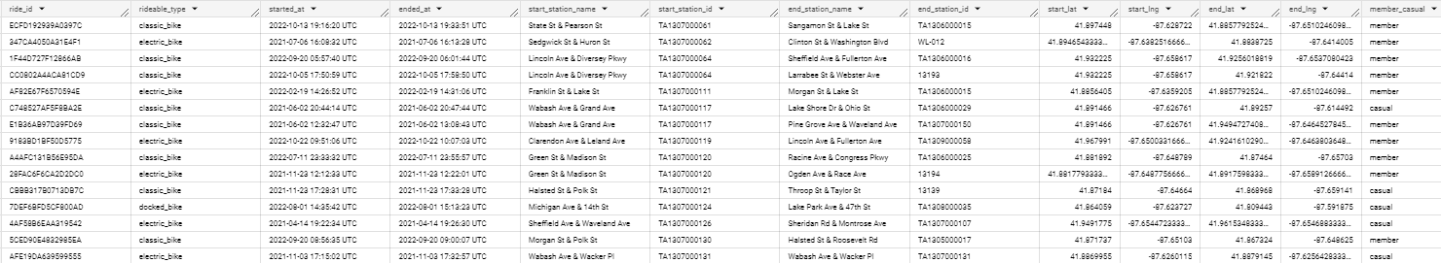
Data sources used
The data was collected and available by Motivate International Inc. (is open-source)

Slide 5
Understanding user

Slide 6
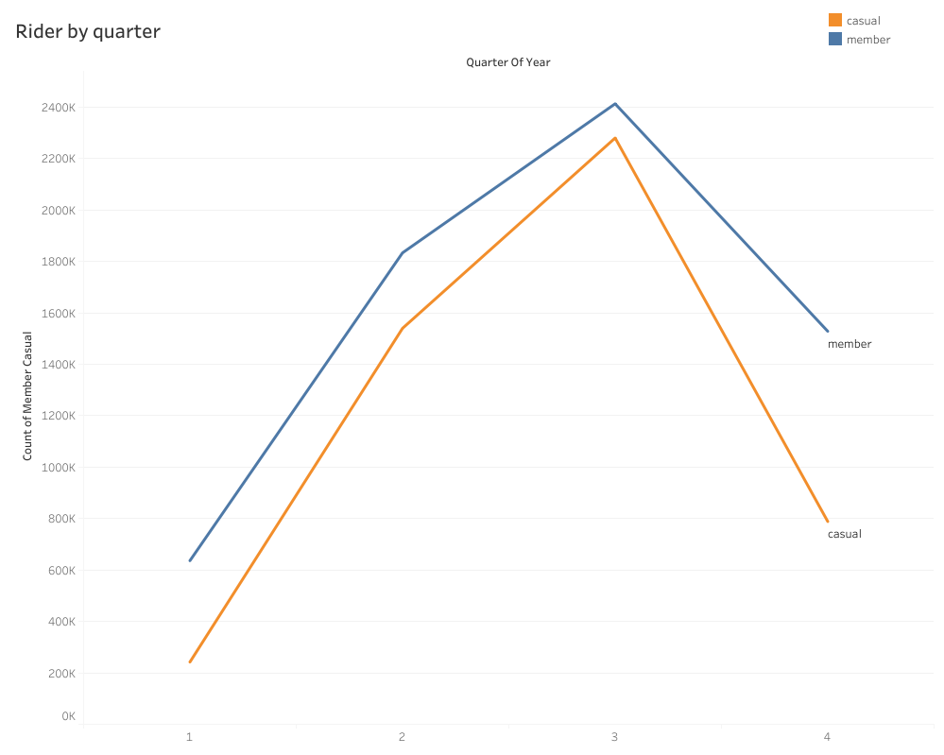
Golden time of the year
Both user significantly raised
In quarters 1 and 2

Slide 7
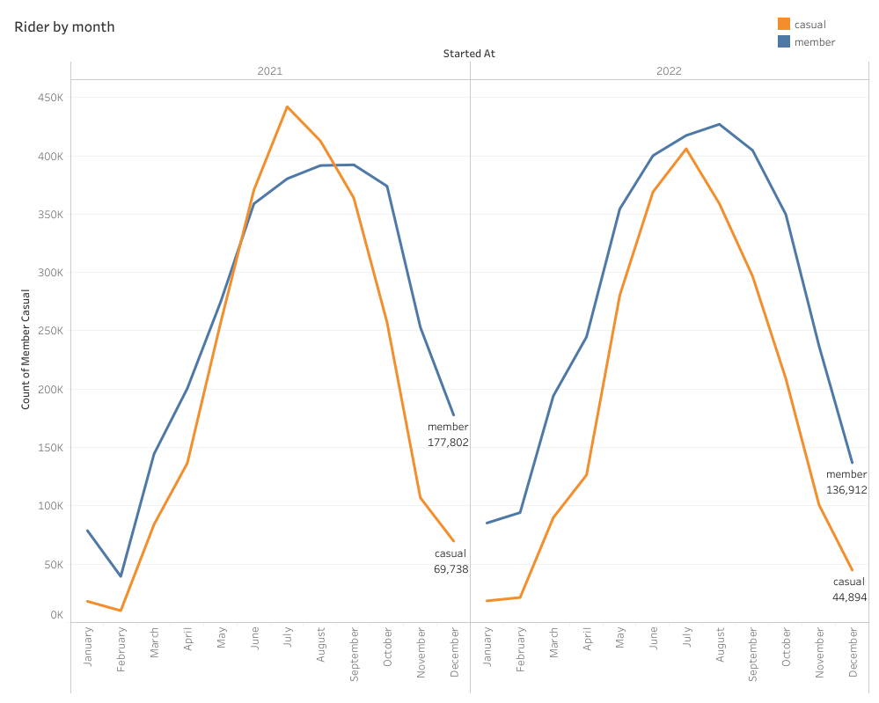
Golden time of the year
Significant rise in February
Before beginning to drop around August and September

Slide 8
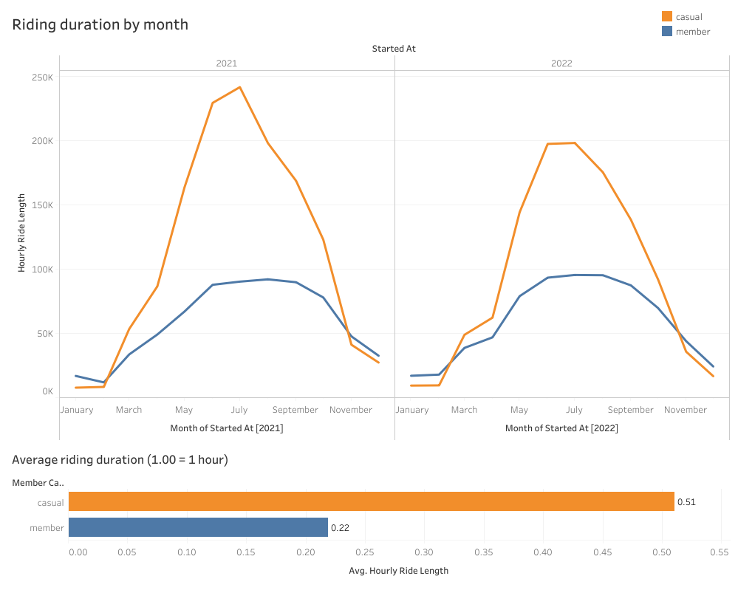
Riding duration
The riding duration is also got higher at time same timeline
Significant difference usage between two user
Casual : ~30 minutes
Annual : ~12 minutes

Slide 9
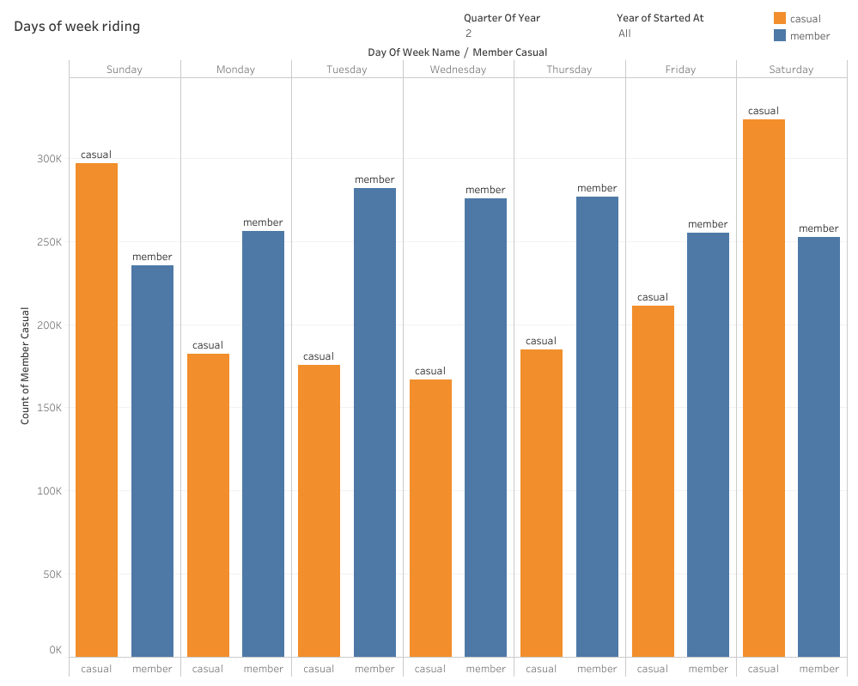
Day of week pattern
In quarters 2 and 3
Casual riders use more bikes on Saturday and Sunday

Slide 10
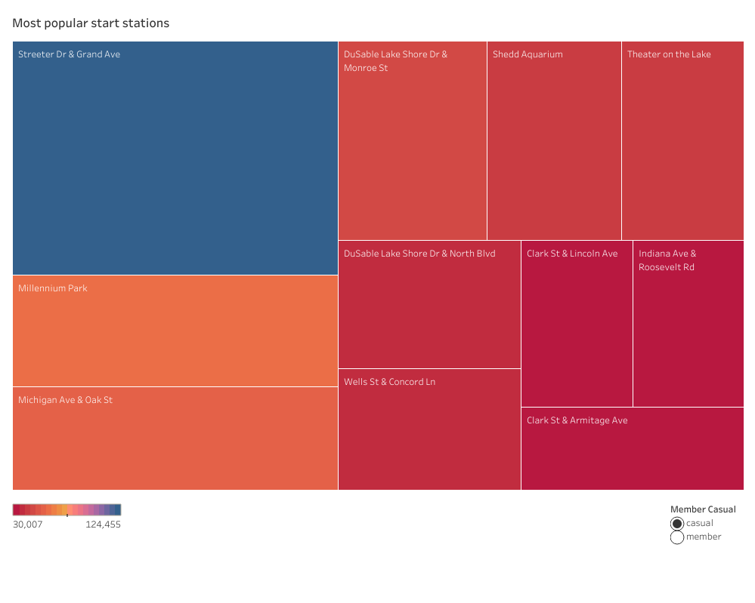
Popular stations
Casual riders popular stations
Streeter Dr & Grand Ave
~ 120,000 used

Slide 11
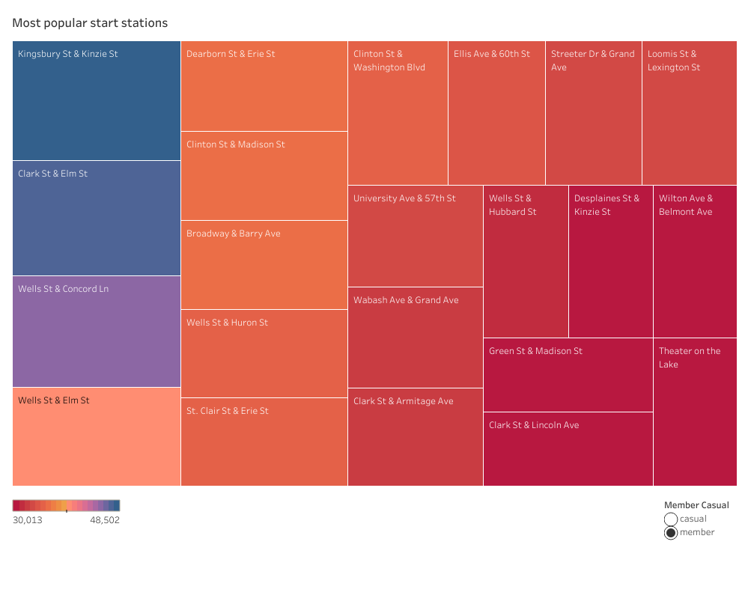
Popular stations
Annual members popular stations
Kingsbury St & Kinzie St
~ 48,000 used

Slide 12
Conclusion

Slide 13
Findings summary
Both casual riders and annual members significantly raised in quarters 1 and 2 (beginning in February) before dropping in quarter 4.
If we focus more on the day of the week, I found that casual members tend to use bikes more on Saturdays and Sundays, especially in quarters 2 and 3.
The average riding duration of casual riders is significantly higher than annual members.
casual member : ~ 0.50 hour/ride (30 minutes)
annual member : ~ 0.20 hour/ride (12 minutes)
The most popular station for casual riders is Streeter Dr & Grand Ave.

Slide 14
Recommendations
Streeter Dr & Grand Ave Station
As the most popular station for casual riders, this location should continue to be prioritized and maintained due to high demand. (significantly higher than the most popular station for annual members)
Weekend Promotions
Create marketing campaigns that highlight the benefits and cost savings of an annual membership compared to casual rides, especially on Saturdays and Sundays.
Enhancing Annual Membership Benefits
To encourage more annual memberships, include exclusive access to certain events or attractions and lower pricing for longer rides
Quarter to launch
Additionally, focusing on quarter 2 and 3 due to casual riders tend to use bikes more on Saturdays and Sundays during these quarters. By launching the project during this time, you can specifically target casual riders who are more active on weekends.

